Slide 1
Parallel Graph Algorithms

Slide 2
Last Lecture
Race
If two operations access the same memory location
At least one of them is write
Try to avoid race
Use atomic primitives
Deterministic parallelism
Make your parallel algorithm execute in the same way as the sequential algorithm

Slide 3
Last Lecture
Random permutation
Find all swaps
Do all of them together if ready
Pack the rest of the elements
Repeat parallel swaps until all done

Slide 4
Parallel graph algorithms

Slide 5
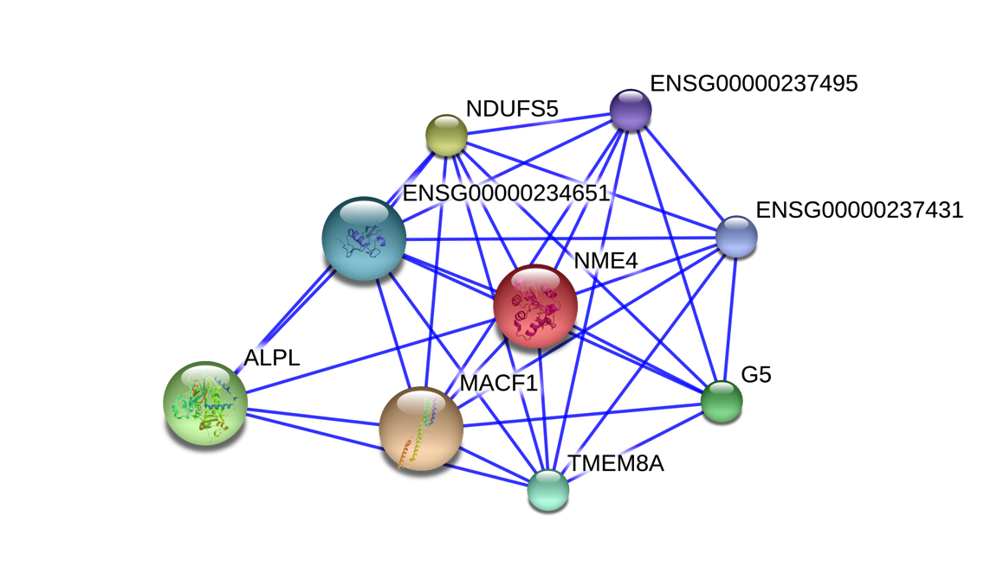
What is a graph?
Edge
Vertex
Vertex
Vertices model objects
Edges model relationships between objects
Carol
David
Alice
Bob
Eve
Fred
Greg
Julian
Hannah
https://commons.wikimedia.org/wiki/File:Protein_Interaction_Network_for_TMEM8A.png
Source: MIT 6.172 by Julian Shun

Slide 6
Social networks
Source: MIT 6.172 by Julian Shun

Slide 7
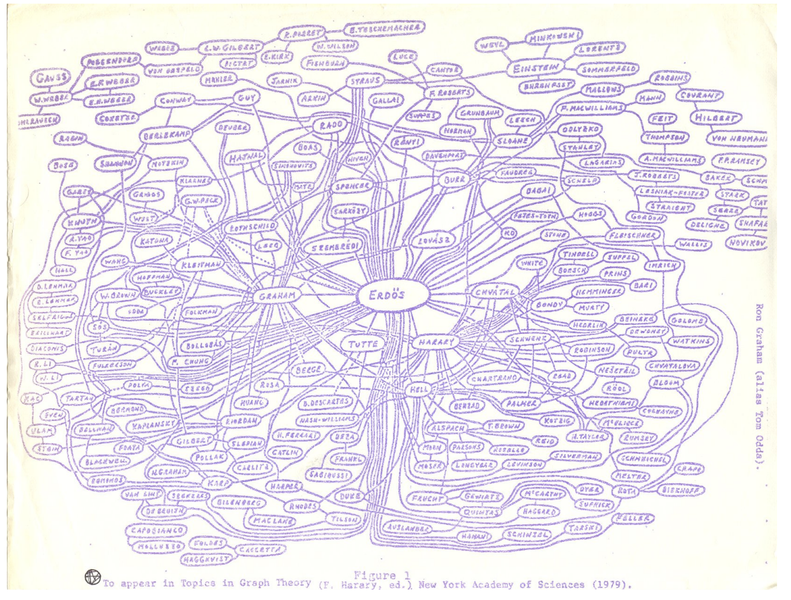
Collaboration networks
Source: MIT 6.172 by Julian Shun
Notes:
Erdos number

Slide 8
Transportation networks
Source: MIT 6.172 by Julian Shun

Slide 9
Computer networks
Source: rawbytes.com
Source: MIT 6.172 by Julian Shun

Slide 10
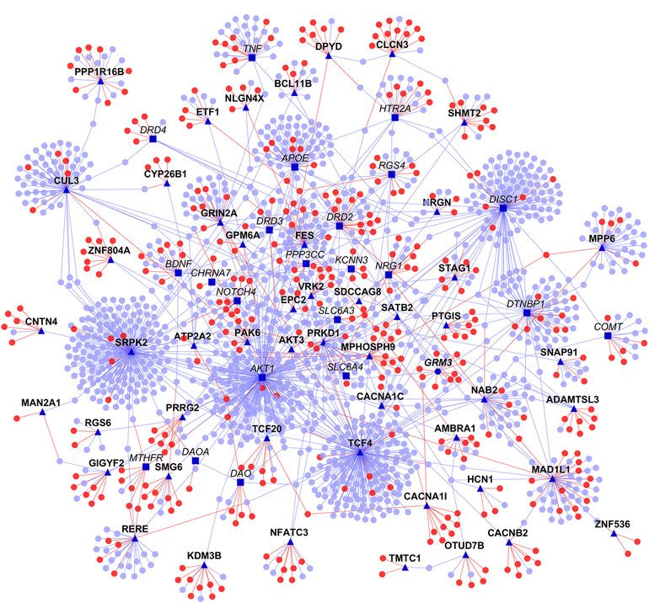
Biological networks
Protein-protein interaction (PPI) networks
Notes:
12M neurons and 120B synapses in mouse brain
Connectomics is an emerging area of neurobiology that extracts brain connectivity graph
Map of neural connections in the brain. Wiring diagram.

Slide 11
Other Applications
Biological networks
Financial transaction networks
Economic trade networks
Food web
Various types of biological networks
Image segmentation in computer vision
Scientific simulations
Many more…
Source: MIT 6.172 by Julian Shun

Slide 12
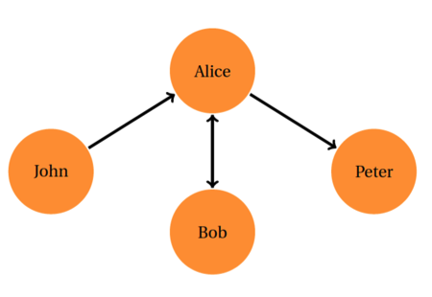
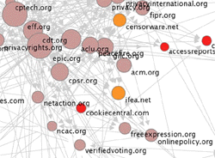
What is a graph?
Edges can be directed / undirected
Relationship can go one way or both ways
http://www3.nd.edu/~dwang5/courses/spring15/assignments/A1/Assignment1_SocialSensing.html
http://farrall.org/papers/webgraph_as_content.html
Source: MIT 6.172 by Julian Shun

Slide 13
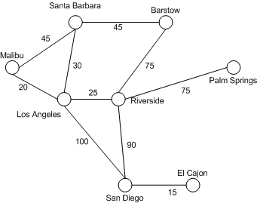
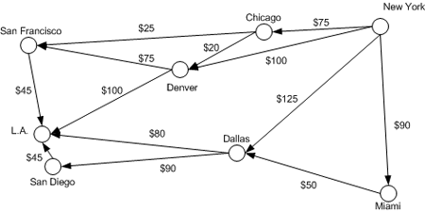
What is a graph?
Edges can be weighted / unweighted (unit weighted)
Denotes “strength”, distance, etc.
Distance between cities
Flight costs
https://msdn.microsoft.com/en-us/library/aa289152(v=vs.71).aspx
Source: MIT 6.172 by Julian Shun
Notes:
Weights can be negative too. Anyone want to give an example?

Slide 14
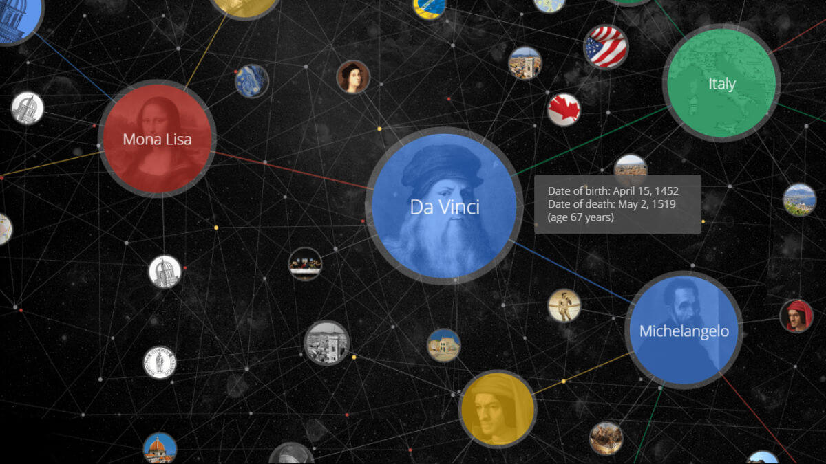
What is a graph?
Vertices and edges can have types and metadata
Google Knowledge Graph
http://searchengineland.com/laymans-visual-guide-googles-knowledge-graph-search-api-241935
Source: MIT 6.172 by Julian Shun

Slide 15
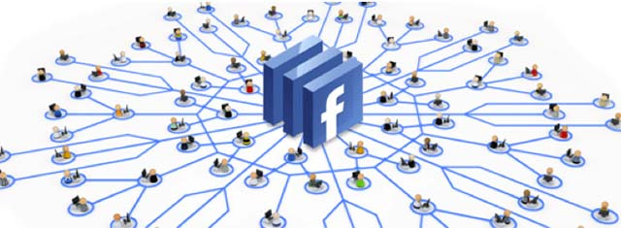

Social network queries
http://www.facebookfever.com/introducing-facebook-new-graph-api-explorer-features/
http://allthingsgraphed.com/2014/10/16/your-linkedin-network/
Examples:
Finding all your friends who went to the same high school as you
Finding common friends with someone
Social networks recommending people whom you might know
Advertisement recommentations
Source: MIT 6.172 by Julian Shun

Slide 16
Transportation network queries
Examples:
Find the cheapest way traveling from one city to the other
Decide where to build a hub/add a flight to make more profit
Find the shortest way to visit a set of locations (e.g., postman)
Source: MIT 6.172 by Julian Shun

Slide 17
Biological network queries
Example:
Find patterns in biological networks
Find similarity between different species
Notes:
12M neurons and 120B synapses in mouse brain
Connectomics is an emerging area of neurobiology that extracts brain connectivity graph
Map of neural connections in the brain. Wiring diagram.

Slide 18
Real-world graph sizes in 2019
Graph | Num. Vertices | Num. Undirected Edges
soc-LiveJournal | 4.8M | 85M
com-Orkut | 3M | 234M
Twitter | 41M | 2.4B
Facebook (2011) [1] | 721M | 68.4B
Hyperlink2014 [2] | 1.7B | 124B
Hyperlink2012 [2] | 3.5B | 225B
Facebook (2018) | > 2B | > 300B
Yahoo! | 272B | 5.9T
Google (2018) | > 100B | 6T
Brain Connectome | 100B (neurons) | 100T (connections)
: Publicly available graphs
[1] The Anatomy of the Facebook Social Graph, Ugander et al. 2011
[2] http://webdatacommons.org/hyperlinkgraph/
: Private graph datasets
Source: CMU 15-853 by Laxman Dhulipala

Slide 19
Graph Representation

Slide 20
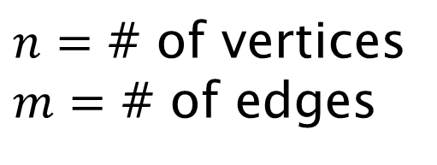
Graph Representations
$n=$ # of vertices
$m=$ # of edges
Vertices labeled from 0 to n-1
0
1
2
3
4
(0,1)
(1,0)
(1,3)
(1,4)
(2,3)
(3,1)
(3,2)
(4,1)
0
0 | 1 | 0 | 0 | 0
1 | 0 | 0 | 1 | 1
0 | 0 | 0 | 1 | 0
0 | 1 | 1 | 0 | 0
0 | 1 | 0 | 0 | 0
O(n²)
1
O(m)
2
3
4
Adjacency matrix
(“1” if edge exists,
“0” otherwise)
Edge list
Space?
Source: MIT 6.172 by Julian Shun
Notes:
Convert labels

Slide 21
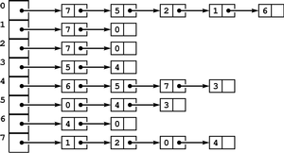
Graph Representations
$n=$ # of vertices
$m=$ # of edges
Adjacency list
Array of pointers (one per vertex)
Each vertex has an unordered list of its edges
Space requirement?
O(n+m)
Can substitute linked lists with arrays for better cache performance
Tradeoff: more expensive to update graph
Source: MIT 6.172 by Julian Shun

Slide 22
Graph Representations
$n=$ # of vertices
$m=$ # of edges
Compressed sparse row (CSR)
Two arrays: Offsets and Edges
Offsets[i] stores the offset of where vertex i’s edges start in Edges
Vertex IDs 0 1 2 3
Offsets
0 | 4 | 5 | 11
...
Edges
2 | 7 | 9 | 16 | 0 | 1 | 6 | 9 | 12
...
How do we compute the offset array?
Space?
O(n+m)
Source: MIT 6.172 by Julian Shun
Notes:
Useful in sparse matrix operations

Slide 23
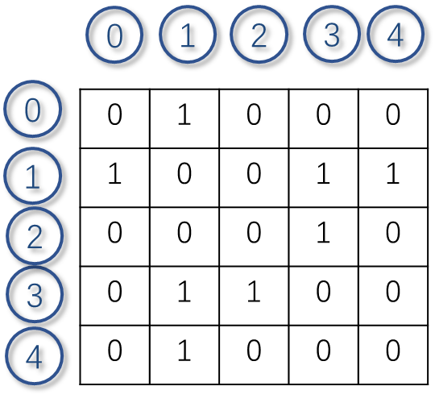
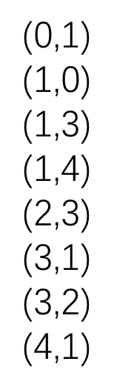
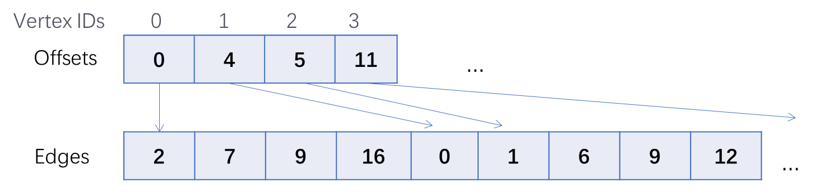
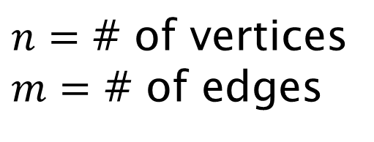
Tradeoffs in Graph Representations
$n=$ # of vertices
$m=$ # of edges
What is the cost of different operations?
 | Adjacency matrix | Edge list | Adjacency list (linked list) | Compressed sparse row
Storage cost / scanning whole graph
Add edge
Delete edge from vertex v
Finding all neighbors of a vertex v
Finding if w is a neighbor of v
O(n²)
O(m)
O(m+n)
O(m+n)
O(1)
O(1)
O(1)
O(m+n)
There are variants and combinations of these representations
O(1)
O(m)
O(deg(v))
O(m+n)
O(m)
O(deg(v))
O(deg(v))
We’ll focus on the static setting in this lecture.
O(n)
O(1)
O(m)
O(deg(v))
O(deg(v))
Source: MIT 6.172 by Julian Shun
Notes:
Adjacency matrix used for dense graphs, good for random queries
Edge list good if graph is given in that format and you don’t want to convert, and also natural for certain “edge-based” algorithms
Adjacency list and CSR good for sparse graphs. Adjacency list better for certain updates but less cache-friendly.

Slide 24
Breadth-First Search (BFS)

Slide 25
Breadth-First Search (BFS)
Given a source vertex s, visit the vertices in order of distance from s
Possible outputs:
Vertices in the order they were visited
D, B, C, E, A
The distance from each vertex to s
A BFS tree, where each vertex has a parent to a neighbor in the previous level
Applications
Betweenness centrality
Eccentricity estimation
Maximum flow
Web crawlers
Network broadcasting
Cycle detection
…
A
B
C
D
E
2 | 1 | 1 | 0 | 1
A
C
E
A
C
E
B
D
source = D
B
D
Source: MIT 6.172 by Julian Shun
BFS tree
Notes:
Garbage collection (mark-and-sweep, stop-and-copy)

Slide 26
Parallel BFS Algorithm
Frontier
1
2
2
1
s
0
2
1
2
Can process each frontier in parallel
Parallelize over both the vertices and their outgoing edges
Source: MIT 6.172 by Julian Shun
Notes:
Generating parent pointer is nondeterministic

Slide 27
Parallel BFS Algorithm
Frontier
Sequentially, each node is visited only once
The first vertex in the previous round that reaches it will be its parent
Use a flag array to indicate if a vertex has been visited before
1
2
2
1
s
0
2
1
2
What if multiple vertices in Round 1 reach the same vertex in Round 2 at the same time?
How to maintain the flag array?
How to compute the next frontier?
Source: MIT 6.172 by Julian Shun
Notes:
Generating parent pointer is nondeterministic

Slide 28
Get the next frontier
//Shared Boolean array visited[]
//visited[v]=true means v has been visited
next_frontier(G, current_frontier) {
par_for (x in current_frontier) {
out_nghs = G[x].out_nghs;
bool out_flag[|out_nghs|] = {false};
par_for (y in out_nghs) {
if ((!visited[y]) && TAS(&visited[y])) {
parent[y] = x;
out_flag[y] = true; }
nghs[i] = filter(out_nghs, out_flag); }
return flatten(nghs);
}
Process each vertex x in the current frontier in parallel
Find all the out neighbors of x
For each the out neighbors y of x
test_and_set (TAS) the visited flag of y, if succeed, x is y’s parent
Pack all x’s “effective” neighbors - those have x as their parent
Flatten all “effective” neighbors of all vertices in the current frontier
No duplicates!

Slide 29

Parallel BFS Algorithm
Frontier
D
A and C compete to visit E
Only one of them can succeed
A
E
B
s
S
F
E
C
G
A
C
Notes:
Generating parent pointer is nondeterministic

Slide 30
Parallel BFS
Generate the first frontier
The source node s
Repeatedly generate the next frontier from the current frontier
Until the frontier is empty – no more vertices added
BFS(G(V,E), s) {
frontier = {s};
n = |V|;
visited = array(n, false);
visited[s] = true;
parent = array(n, -1);
while (|frontier|) {
frontier = next_frontier(G, frontier);}
return parent;
}

Slide 31
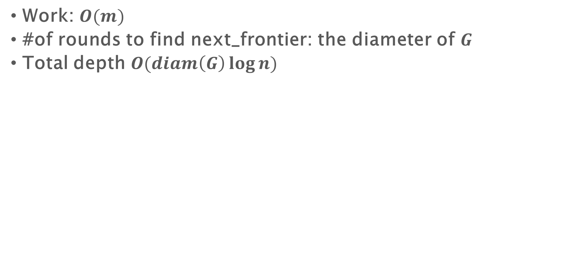
Parallel BFS
Work: $O(m)$
#of rounds to find next_frontier: the diameter of $G$
Total depth $O(diam\left(G\right)\log{n})$

Slide 32
Parallel connected components

Slide 33
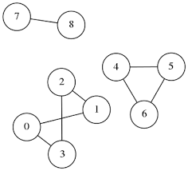
Connected components
Given an undirected graph, label all vertices such that L(u) = L(v) if and only if there is a path between u and v
BFS depth is proportional to diameter
Works well for graphs with small diameter
But order doesn’t matter!
Today we will see a randomized algorithm that takes O((n+m)log n) work and O(log n) depth
Work-efficient algorithms are more complicated
8
8
4
4
1
1
4
1
1
Source: http://www.martinbroadhurst.com/connected-components-of-a-graph-in-c.html

Slide 34
Connectivity component - random mate
Similar as the list ranking problem
Flip a random coin, hook tails to heads, contract, repeat
1
2
9
12
1
2
9
12
4
3
7
8
11
4
3
7
8
11
10
10
5
6
5
6
flip coins
(red = heads)
Source: Blelloch and Maggs, 6886-s18, lecture5.2

Slide 35
Random mate
1
2
9
12
12
1
2
9
4
3
7
8
4
3
7
8
11
11
5
6
5
6
10
10
flip coins
(red = heads)
form stars
A tail node v will be removed and hooked to an arbitrary head neighbor w (if any)
v will be assigned to w’s connected component
2
12
3
8
10
6
Source: Blelloch and Maggs, 6886-s18, lecture5.2
contract

Slide 36
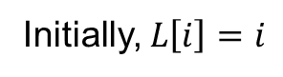
Random Mate
Initially, $L\left[i\right]=i$
cc_random_mate(L, E) {
if (|E|=0) return L;
1. flip coins for all n vertices;
2. for v where flip(v)=Tails, hook to an arbitrary Heads neighbor w; set L(v)=w;
3. //remove self edges, can be done using a filter
E’ = { (L(u),L(v)) | (u,v) ∈ E and L(u) ≠ L(v) }
4. L’=cc_random_mate(L, E’);
5. //restore v’s connectivity info
for v where flip(v)=Tails, let L’(v)=L’(w);
return L’
Flip a coin for each node
A tail node v will be removed and hooked to an arbitrary head neighbor w (if any)
v will be assigned to w’s connected component
Contract: the new label is the center of the star (a Heads vertex)
Get a smaller graph – repeat
After recursive call returns, restore v’s info from w
1
2
9
12
2
12
4
3
7
8
11
3
8
10
5
6
6
10
Edge (u,v) -> (L(u),L(v))
e.g., Edge (5,6) -> (3,6)
e.g., L[5]=3

Slide 37
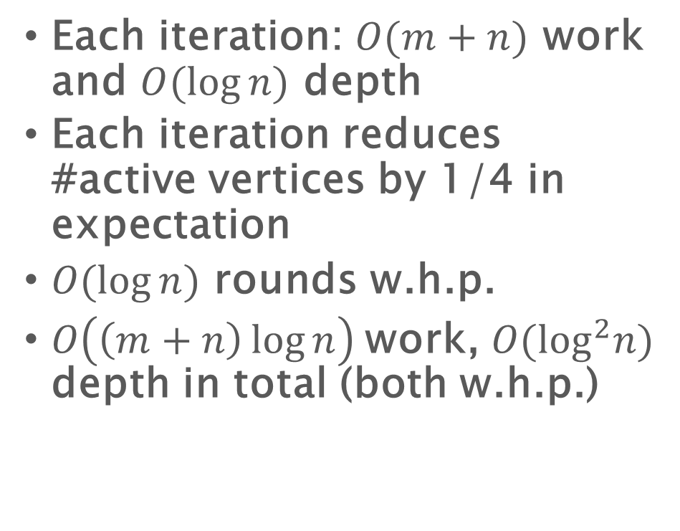
Random Mate
cc_random_mate(L, E) {
if (|E|=0) return L;
1. flip coins for all n vertices;
2. for v where flip(v)=Tails, hook to an arbitrary Heads neighbor w; set L(v)=w;
3. //remove self edges, can be done using a filter
E’ = { (L(u),L(v)) | (u,v) ∈ E and L(u) ≠ L(v) }
4. L’=cc_random_mate(L, E’);
5. //restore v’s connectivity info
for v where flip(v)=Tails, let L’(v)=L’(w);
return L’
Each iteration: $O(m+n)$ work and $O(log⁡n)$ depth
Each iteration reduces #active vertices by 1/4 in expectation
$O(log⁡n)$ rounds w.h.p.
$O\left(\left(m+n\right)\log{n}\right)$work, $O(\log^{2}n)$ depth in total (both w.h.p.)

Slide 38
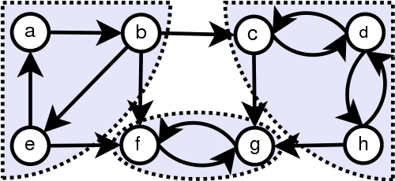
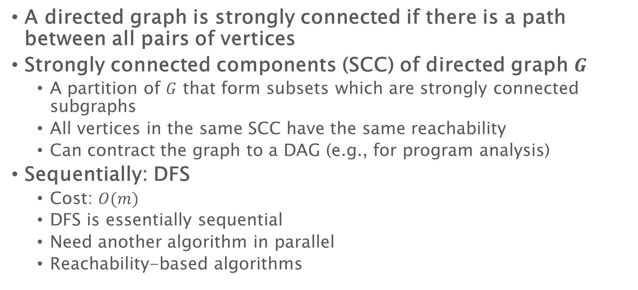
Strongly connected components (SCC)
A directed graph is strongly connected if there is a path between all pairs of vertices
Strongly connected components (SCC) of directed graph $G$
A partition of $G$ that form subsets which are strongly connected subgraphs
All vertices in the same SCC have the same reachability
Can contract the graph to a DAG (e.g., for program analysis)
Sequentially: DFS
Cost: $O(m)$
DFS is essentially sequential
Need another algorithm in parallel
Reachability-based algorithms
Source: Wikipedia

Slide 39
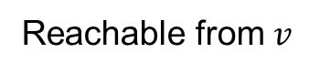
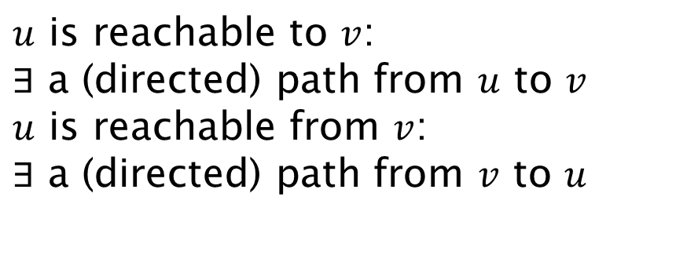
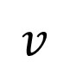
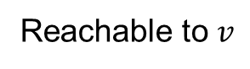
Reachability
$u$ is reachable to $v$:
$∃$ a (directed) path from $u$ to $v$
$u$ is reachable from $v$:
$∃$ a (directed) path from $v$ to $u$
$$v$$
Reachable from $v$
Reachable to $v$

Slide 40
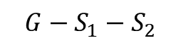
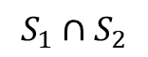
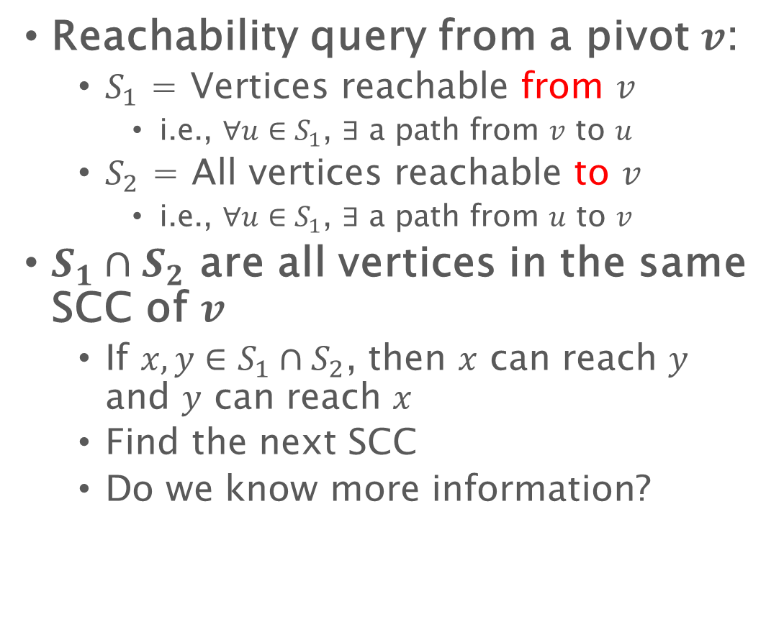
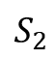
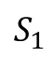
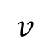
SCC – a divide-and-conquer algorithm
Reachability query from a pivot $v$:
$S_{1}$ = Vertices reachable from $v$
i.e., $∀u∈S_{1}$, $∃$ a path from $v$ to $u$
$S_{2}$ = All vertices reachable to $v$
i.e., $∀u∈S_{1}$, $∃$ a path from $u$ to $v$
$S_{1}∩S_{2}$ are all vertices in the same SCC of $v$
If $x,y∈S_{1}∩S_{2}$, then $x$ can reach $y$ and $y$ can reach $x$
Find the next SCC
Do we know more information?
$$S_{1}$$
$$v$$
$$S_{1}∩S_{2}$$
$$S_{2}$$
$$G−S_{1}−S_{2}$$

Slide 41
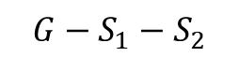
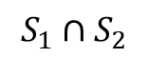
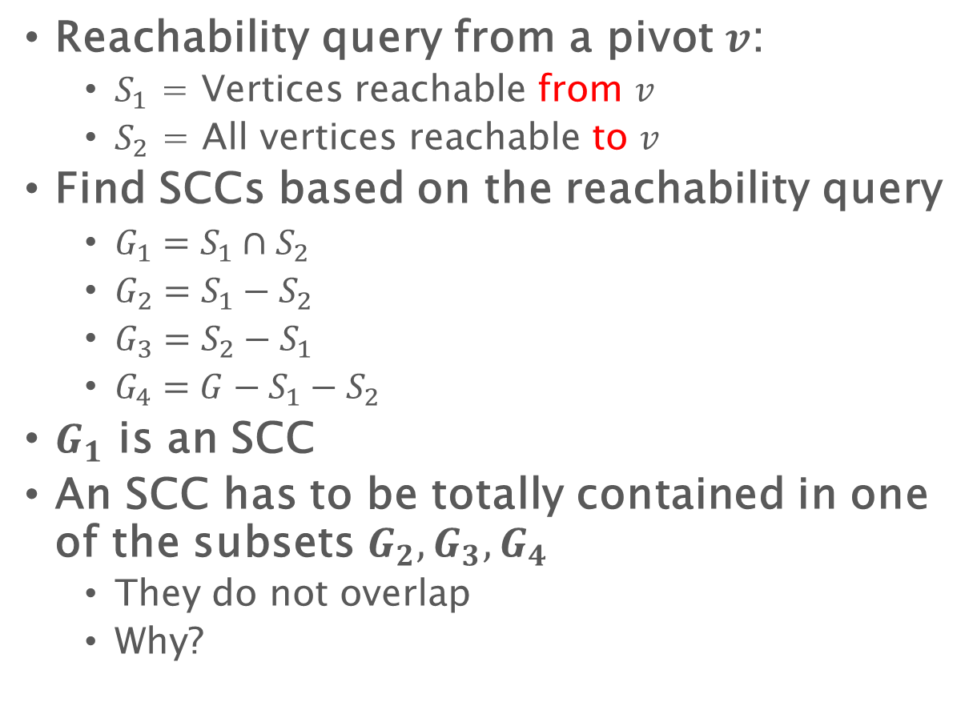
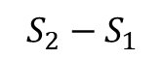
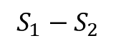
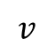
SCC – a divide-and-conquer algorithm
Reachability query from a pivot $v$:
$S_{1}$ = Vertices reachable from $v$
$S_{2}$ = All vertices reachable to $v$
Find SCCs based on the reachability query
$G_{1}=S_{1}∩S_{2}$
$G_{2}=S_{1}−S_{2}$
$G_{3}=S_{2}−S_{1}$
$G_{4}=G−S_{1}−S_{2}$
$G_{1}$ is an SCC
An SCC has to be totally contained in one of the subsets $G_{2},G_{3},G_{4}$
They do not overlap
Why?
?
?
$$S_{1}−S_{2}$$
$$v$$
$$S_{1}∩S_{2}$$
?
$$S_{2}−S_{1}$$
$$G−S_{1}−S_{2}$$

Slide 42
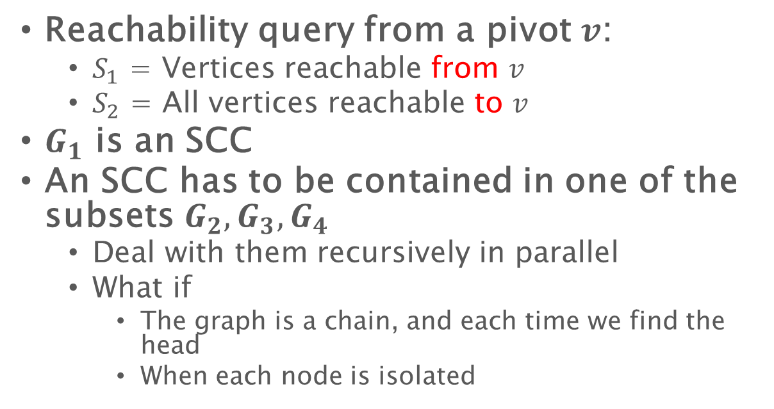
SCC – a divide-and-conquer algorithm
Reachability query from a pivot $v$:
$S_{1}$ = Vertices reachable from $v$
$S_{2}$ = All vertices reachable to $v$
$G_{1}$ is an SCC
An SCC has to be contained in one of the subsets $G_{2},G_{3},G_{4}$
Deal with them recursively in parallel
What if
The graph is a chain, and each time we find the head
When each node is isolated
?
?
$$S_{1}−S_{2}$$
$$v$$
$$S_{1}∩S_{2}$$
?
$$S_{2}−S_{1}$$
$$G−S_{1}−S_{2}$$

Slide 43
SCC – an iterative algorithm [BGSS]
Find SCCs based on the reachability query of a pivot – 4 subgraphs
Reachable from & to the pivot: an SCC
Remove all edges/vertices
If an edge goes across two subgraphs, we can remove it
Filter out these edges
Continue to choose another vertex for reachability query
$$S_{1}−S_{2}$$
$$v$$
$$S_{1}∩S_{2}$$
$$S_{2}−S_{1}$$
$$G−S_{1}−S_{2}$$

Slide 44
SCC – an iterative algorithm [BGSS]
If an edge connects two edges in two subgraphs, remove it
Reachable from $v$
Reachable to $v$

Slide 45
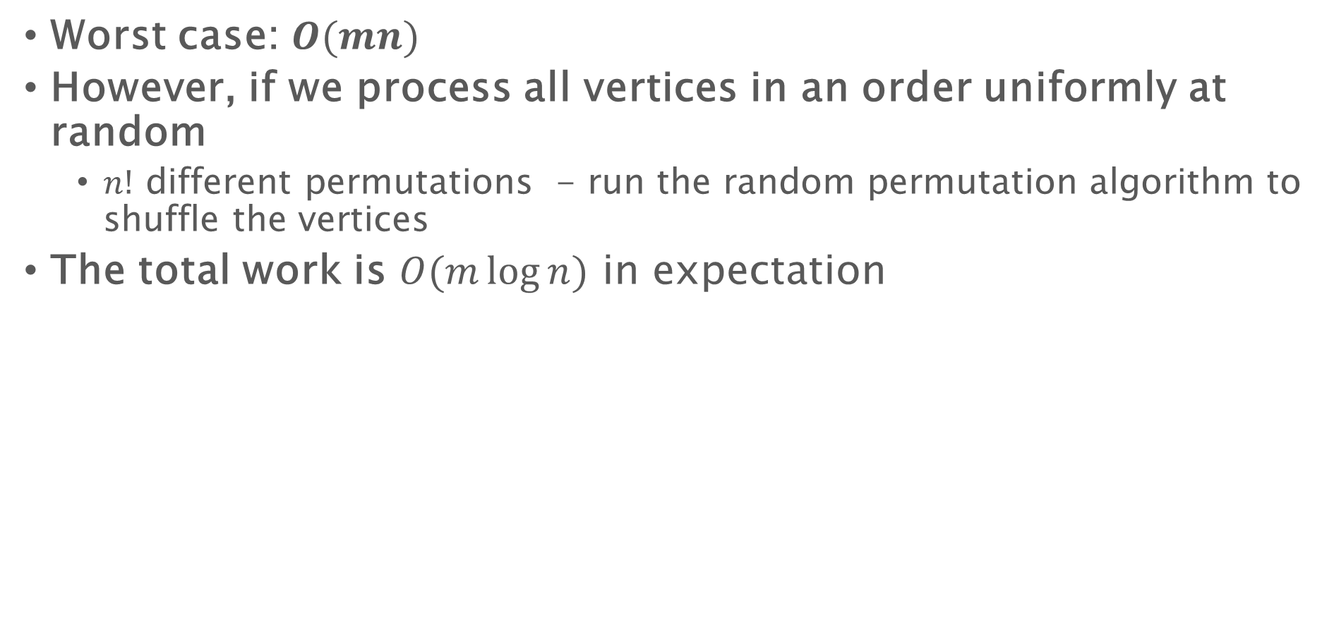
SCC – an iterative algorithm [BGSS]
Worst case: $O(mn)$
However, if we process all vertices in an order uniformly at random
$n!$ different permutations - run the random permutation algorithm to shuffle the vertices
The total work is $O(m\log{n})$ in expectation

Slide 46
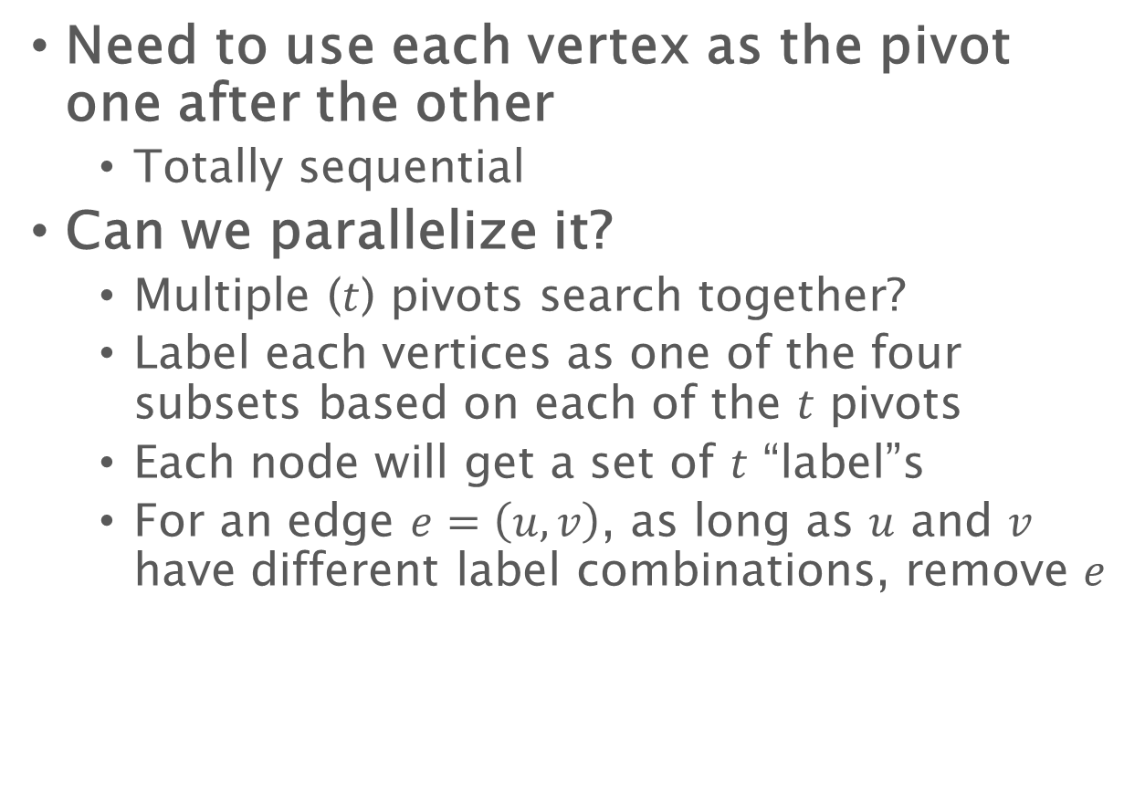
SCC – an iterative algorithm [BGSS]
Need to use each vertex as the pivot one after the other
Totally sequential
Can we parallelize it?
Multiple ($t$) pivots search together?
Label each vertices as one of the four subsets based on each of the $t$ pivots
Each node will get a set of $t$ “label”s
For an edge $e=\left(u,v\right)$, as long as $u$ and $v$ have different label combinations, remove $e$
?
?
$$S_{1}−S_{2}$$
$$v$$
$$S_{1}∩S_{2}$$
?
$$S_{2}−S_{1}$$
$$G−S_{1}−S_{2}$$

Slide 47
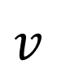
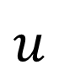
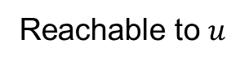
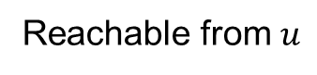
SCC – an iterative algorithm [BGSS]
If an edge connects two edges in two subgraphs, remove it
$$v$$
$$u$$
Reachable from $v$
Reachable to $v$
Reachable from $u$
Reachable to $u$

Slide 48
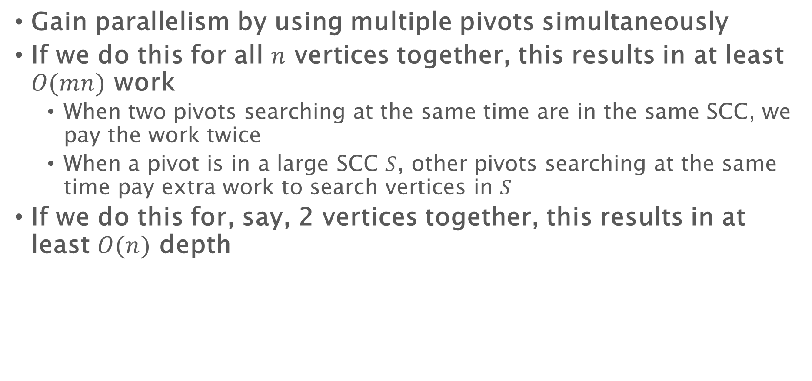
SCC – the parallelized iterative algorithm [BGSS]
Gain parallelism by using multiple pivots simultaneously
If we do this for all $n$ vertices together, this results in at least $O(mn)$ work
When two pivots searching at the same time are in the same SCC, we pay the work twice
When a pivot is in a large SCC $S$, other pivots searching at the same time pay extra work to search vertices in $S$
If we do this for, say, 2 vertices together, this results in at least $O(n)$ depth

Slide 49
Prefix doubling
1
2
3
4
5
6
7
8
9
10
11
12
13
14
15
16
17
…
In the order by the random permutation
Round 1, use 1 pivot; perform the iterative algorithm
Round 2, use 2 pivots; perform the iterative algorithm
Round 3, use 4 pivots; perform the iterative algorithm
Round 4, use 8 pivots; perform the iterative algorithm
……

Slide 50
Prefix doubling
In the order by the random permutation
Round 1, use 1 pivot; perform reachability queries
Filter out useless edges
Round 2, use 2 pivots; perform reachability queries
Filter out useless edges
Round 3, use 4 pivots; perform reachability queries
Filter out useless edges
Round 4, use 8 pivots; perform reachability queries
Filter out useless edges
……

Slide 51
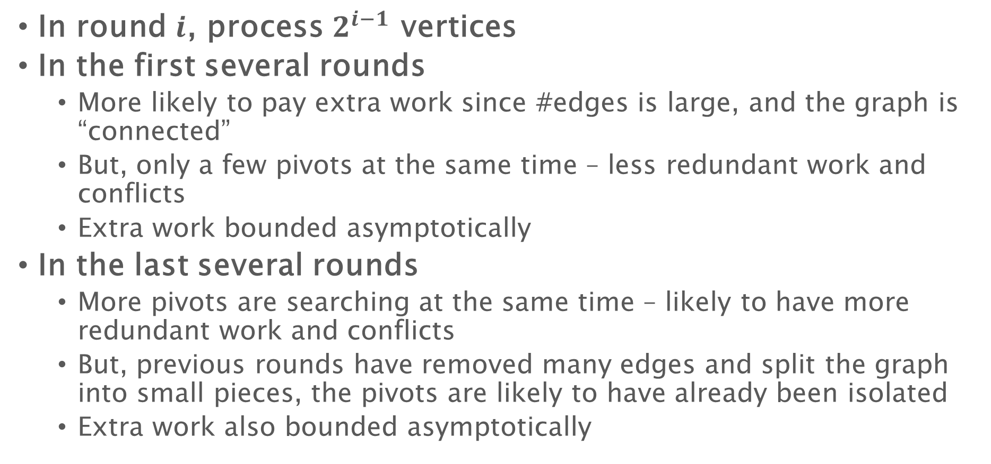
Prefix doubling
In round $i$, process $2^{i−1}$ vertices
In the first several rounds
More likely to pay extra work since #edges is large, and the graph is “connected”
But, only a few pivots at the same time – less redundant work and conflicts
Extra work bounded asymptotically
In the last several rounds
More pivots are searching at the same time – likely to have more redundant work and conflicts
But, previous rounds have removed many edges and split the graph into small pieces, the pivots are likely to have already been isolated
Extra work also bounded asymptotically

Slide 52
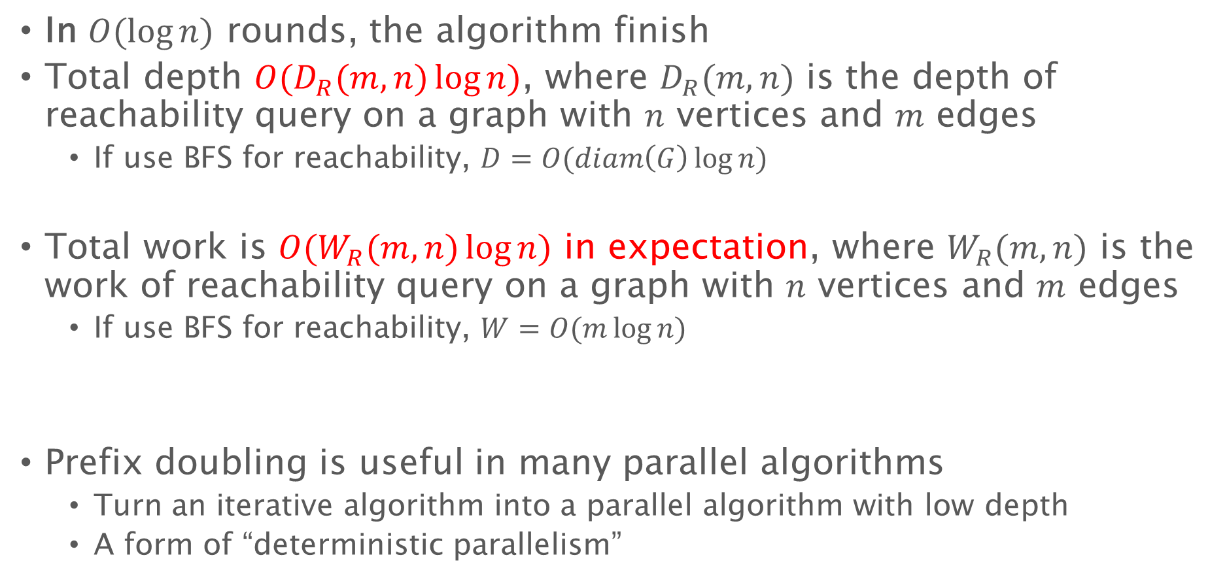
Prefix doubling for SCC
In $O(\log{n})$ rounds, the algorithm finish
Total depth $O(D_{R}(m,n)\log{n})$, where $D_{R}(m,n)$ is the depth of reachability query on a graph with $n$ vertices and $m$ edges
If use BFS for reachability, $D=O(diam\left(G\right)\log{n})$
Total work is $O(W_{R}(m,n)\log{n})$ in expectation, where $W_{R}(m,n)$ is the work of reachability query on a graph with $n$ vertices and $m$ edges
If use BFS for reachability, $W=O(m\log{n})$
Prefix doubling is useful in many parallel algorithms
Turn an iterative algorithm into a parallel algorithm with low depth
A form of “deterministic parallelism”

